Slide 1

Harnessing the Cloud to Create Social Mobile Apps That Scale
Jim Zimmerman
CTO, Thuzi (Facebook Preferred Partner)
@jimzim
Abe Pachikara
US Cloud Computing Developer Adoption Lead, Microsoft
Twitter: @abepachikara

Slide 2
Agenda – Using the Cloud to…
  The Grand Intersection: Mobile, Social, Success ☺
  The Challenges
  How to, Lessons, Tips and Tricks
  Examples
1

Slide 3
Mobile Usage of Smartphones Simply Exploding
Smartphones up 75% in 2010 worldwide from 310 million in 2010 to 390 million in 2013 - IDC
Source: IDC
Source: The Nielsen Company
2

Slide 4
Social is Getting Bigger Too, Particularly on Mobile
900
Million
90
200
Million
2x
# Objects that people interact with (pages, groups, events and community pages)
Average user creates 90 content pieces each month
# Active users currently accessing Facebook through their mobile devices
Use of Facebook from a mobile device vs. non-mobile device
Source: Facebook
3

Slide 5
Social Promotions running on Facebook spike easy
Fans
Week 1
Week 2
Outback Steakhouse
350,000 people sign up - - in 12 days
670,000 in 5 weeks, (but that is only .17% of Facebook at time of the promotion!)
Day 1 Signups for Thuzi’s clients
4

Slide 6
But Social Apps, Well That’s Another Story:
They Need Amazing Scale
The Backend Need:
Run 1 million updates, daily
(that’s right,
daily !)
…. And Each User Has 50 Friends
… Let’s say only 20k users buy the app, run it on…
Mobile phones
& Tablets
The App:
Friend Related Status or Data
5

Slide 7
So Let’s Talk About Relevant Design Patterns
The Backend Need:
Run 1 million updates, daily
(that’s right,
daily !)
The App:
Friend Related Status or Data

Slide 8

Multiple Devices All Talking to the Cloud
If the app you are creating is successful, how will you scale?
How quick do you want to get to market?
Database, document storage, async coding practices
Nearly unlimited access to more compute power when needed
Do you want to spend more money on IT staff to manage servers or spend more on developers
7

Slide 9















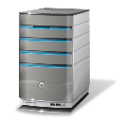





So…. What is the Windows Azure Platform?
platform
AppFabric
Compute
Storage
Management
Relational data
Management
Connectivity
Access control
  Developer Experience - Use existing skills and tools.
8

Slide 10
Data Strategies for Cloud Scale Apps
Partitioning data key to cloud scale apps
Horizontally partition for scale out
Vertically partition for cost/performance
Choose appropriate partition keys
Table storage requires different approach to data modeling.
Don’t be afraid to aggressively de-normalize and duplicate data

Slide 11
Scaling to millions in the Cloud
The Device:
Mobile phone
Tablet
NoSQL
Storage
Get Newsfeed
Web Server Instances
(Web Roles)
Background Processes
(Worker
Roles)
Message Queues
Post Message
Relational Database
External APIs
10

Slide 12
Client side Javascript and HTML 5 Features
$.post("./Service/AddMessage", personMsg, function (result) {
$.ajax(“./Service/GetFeed”, function (r) {
saveToLocalStorage(“data”, r.data);
});
});
function saveToLocalStorage(key, value) {
if (typeof (localStorage) == 'undefined') {
// alert('Your browser does not support HTML5 localStorage. Try upgrading.');
} else {
try {
var serialized = JSON.stringify(value);
localStorage.setItem(key, serialized); //saves to the database, "key", "value"
} catch (e) {
alert(e);
}
}
}
11

Slide 13
Using the Windows Azure Toolkit for scheduling
CloudEngine engine = new CloudEngine();
Action<MessageHandlerSettings> configSettings = c =>
{
c.BatchSize = 32;
c.MaxThreads = 1;
c.MaxRetries = 1;
c.IntervalBetweenRuns = TimeSpan.FromMinutes(1);
};
engine.WithMessageHandler<PersonMessage, CallPersonCommand>(configSettings);
// Azure C# Side
var blob = new EntitiesBlobContainer<PersonMessageView>();
var data = blob.Get(“personMessages");
var msgs = data.AllMessages;
return msgs;

Slide 14
Examples – Ruby Tuesday Bracket challenge
Leaderboard
  How do you figure out who is winning among your friends
Bracket points
  Show points so far on individual brackets
  20 points win round 1, 40 round 2, 80 round 3, etc
13

Slide 15
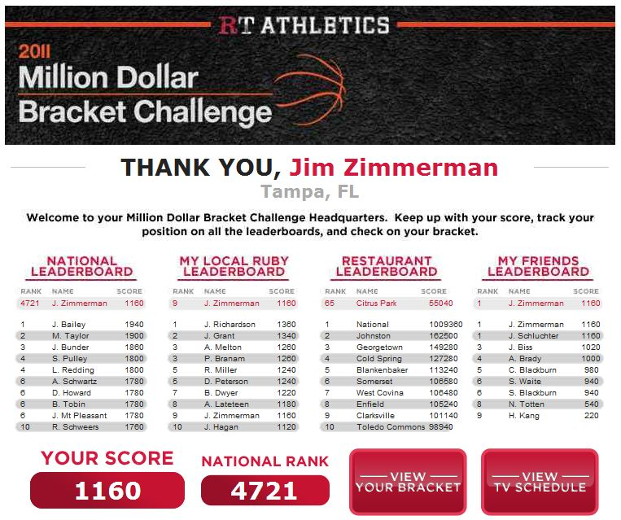
Ruby Tuesday Facebook Leaderboard
14

Slide 16
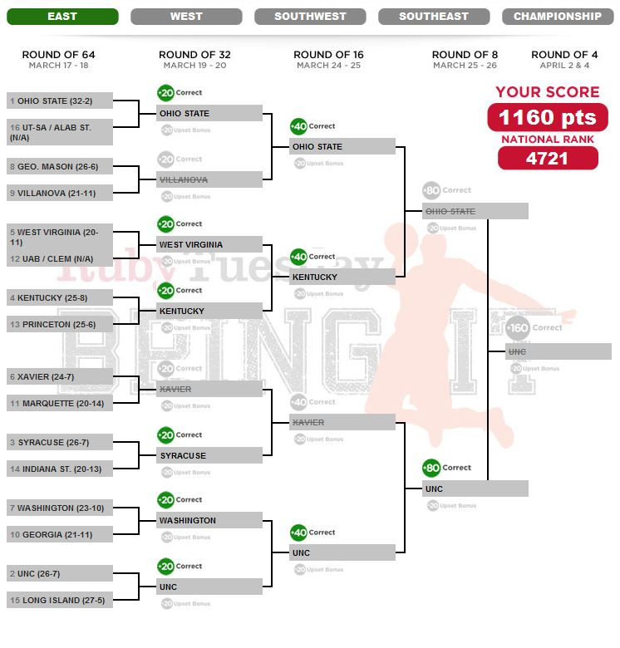
Ruby Tuesday Bracket – Viewable from Devices also
15

Slide 17
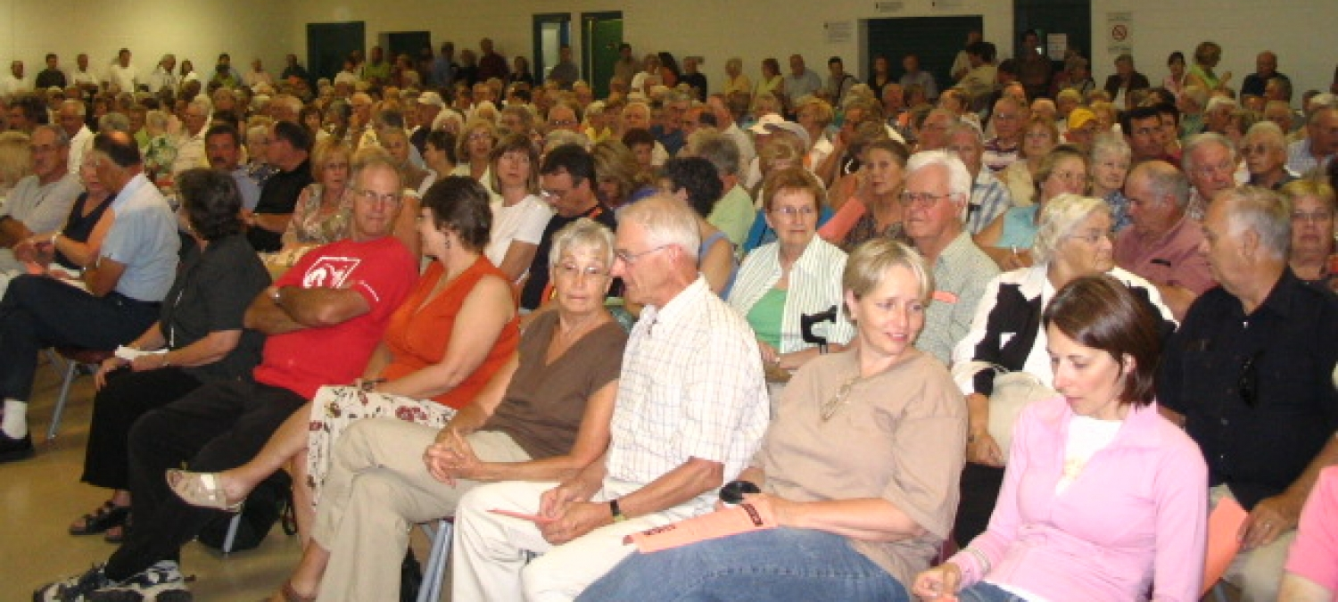
TownHall
A social engagement platform hosted on Windows Azure and available for organizations to customize and monetize
16

Slide 18
TownHall
Building Blocks
Also:
Native code
  iPhone, iPad, WP7, Blackberry, Android – April 30th
  Titanium has “Accelerator” that is cross platform
Scales very well
  Can handle 8 million per hour
To deploy…
  Create Azure account
  Run scripts to deploy the database
  Use VS Express 2010 or the trial
Moderated forums
Community forums
Themes available out of the box
Points + Badges for engagement
Events functionality
Polling
Ideas site
Scalable (cloud hosted)
Customizable
17

Slide 19
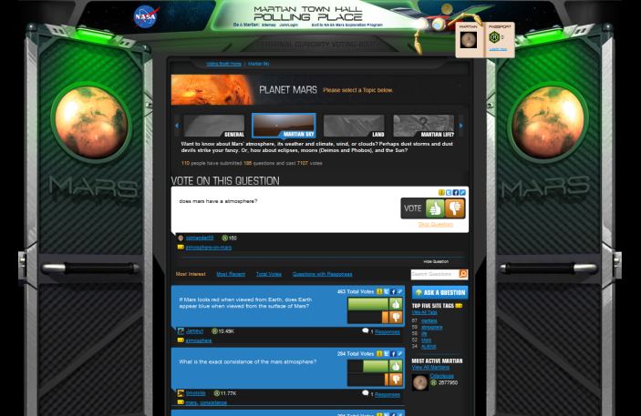
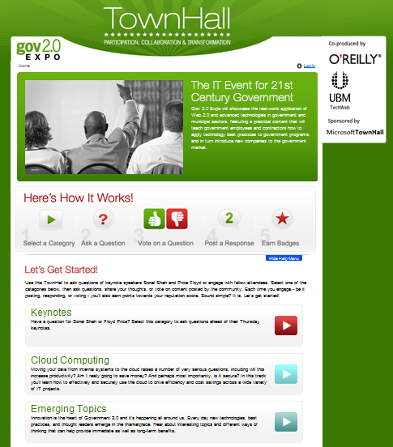
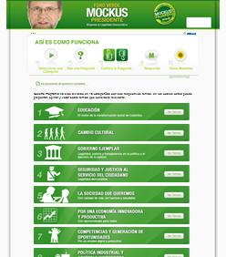
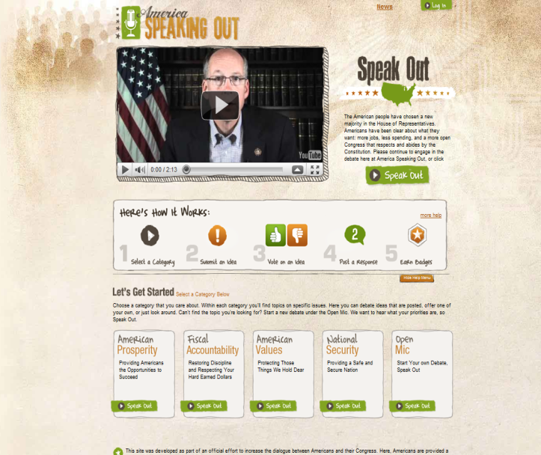
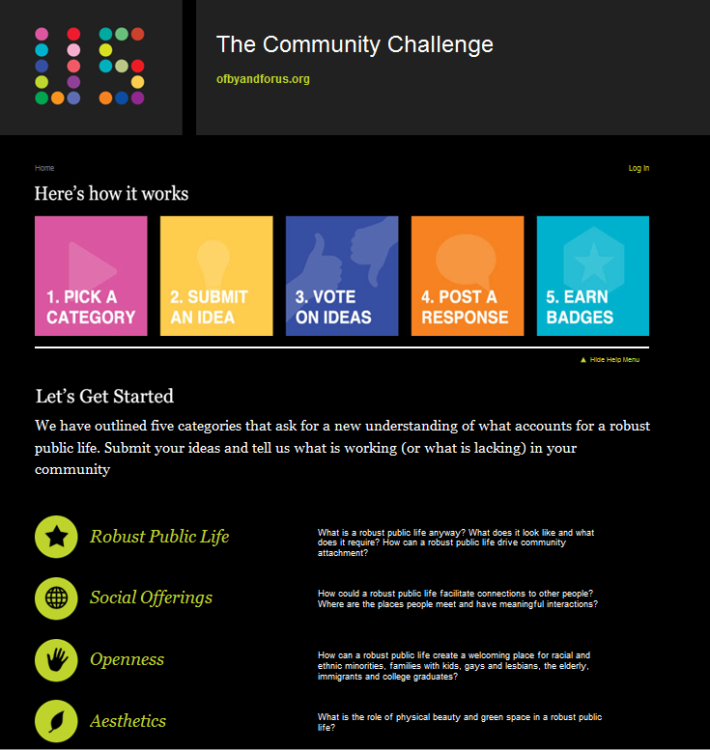
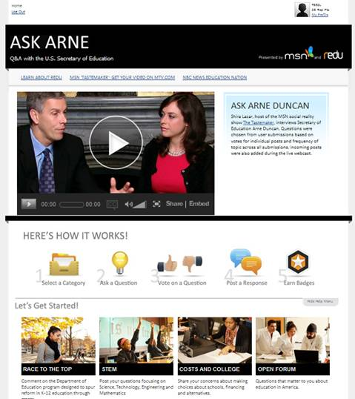
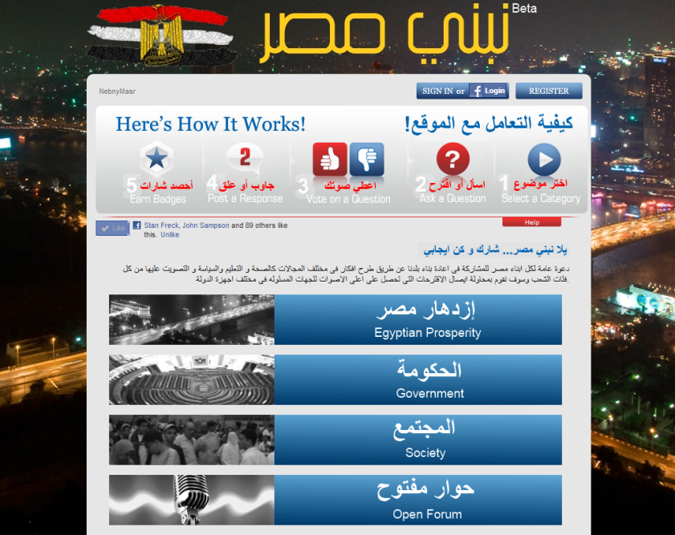
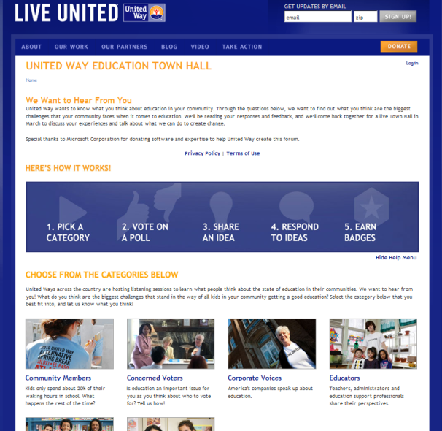
Examples of Townhall in Actual Use
NASA JPL
“BE A MARTIAN”
UNITED WAY WORLDWIDE “CAMPAIGN FOR COMMON GOOD”
COLOMBIAN PRESIDENTIAL
CANDIDATE
CEOs FOR CITIES
“OF, BY AND FOR YOU”
NEBNY EGYPTIAN CROWDSOURCING
US HOUSE REPUBLICANS
“AMERICA SPEAKING OUT”
WHITE HOUSE/US DEPT OF EDUCATION “ASK ARNE”b
O’REILLY MEDIA
GOV 2.0 FORUM

Slide 20
Resources you can use today
General Bits and Runtimes
Facebook related assets:
  C# SDK – http://facebooksdk.codeplex.com/
  Azure Toolkit – http://azuretoolkit.codeplex.com/
  Technical walkthru - http://www.devx.com/MS_Azure/Article/46308
  Mobile Assets: Tapping the cloud for Windows Phone apps
  Cloud cover session
  Team blog posting
Apps To Repurpose
TownHall App can be found here –
Next major rev will be delivered by April 30
Here’s a useful datasheet
Try Azure for yourself:
http://bit.ly/jimonazure,
Promocode jimonazure
19

Slide 21



© 2010 Microsoft Corporation. All rights reserved. Microsoft, Windows, Windows Vista and other product names are or may be registered trademarks and/or trademarks in the U.S. and/or other countries.
The information herein is for informational purposes only and represents the current view of Microsoft Corporation as of the date of this presentation. Because Microsoft must respond to changing market conditions, it should not be interpreted to be a commitment on the part of Microsoft, and Microsoft cannot guarantee the accuracy of any information provided after the date of this presentation.
MICROSOFT MAKES NO WARRANTIES, EXPRESS, IMPLIED OR STATUTORY, AS TO THE INFORMATION IN THIS PRESENTATION.

Slide 22
Appendix – Other resources you may like

Slide 23

Cloud Scenarios
“On and Off “
“Growing Fast“
Inactivity
Period
Compute
Compute
Average
Usage
Average Usage
Time
Time
  On and off workloads (e.g. HPC or batch job)
  Over provisioned capacity is wasted
  Time to market can be cumbersome
  Successful services needs to grow/scale
  Remove upfront CAPEX investment barrier
  Complex lead time for deployment
“(Un)predictable Bursting“
“Business Critical LOB“
Compute
Compute
Average Usage
Average Usage
Time
Time
  Unexpected/unplanned peak in demand
  Services with seasonality trends
  Can’t over provision for extreme cases
  Business/divisional opportunities
  Time to market – agile support of business
  Development and deployment backlog

Slide 24
Extra Credit: Windows Azure Resources
Learn
“What is the Windows Azure Platform?” 4 min video
Windows Azure Case Studies
Deploying a large scale app, Virtual Lab
Azure developer center
Using your MSDN Premium Benefits
Microsoft’s Datacenters
Security Talk Series
Watch Professional Developers Conference sessions
Get
Windows Azure Tools for Microsoft Visual Studio
Windows Azure Platform Training Kit
Interoperability tools
Join
BizSpark, for startups
The vibrant online community – https://channel9.msdn.com/Shows/Cloud+Cover
Also on Facebook – www.facebook.com/windowsazure

